Slide 1
Parameters
Code abbrev | Model symbol | Full parameter name (fix or potentially estimate*)
delM | δ_{M} | Shape corrector (fix)
dV | d_{V} | Dry weight density (fix)
sJAm | Jª_{Am} | Area-specific assimilation rate
sJM | J^{v}_{M} | Volume-specific maintenance costs (fix)
WB0 | W_{B0} | Initial egg weight (fix)
Lwp | L^{M}_{p} | Total length at puberty (fix)
yAV | y_{AV} | Yield of assimilates on volume, i.e. starvation
yBA | y_{BA} | Yield of egg buffer on assimilates, i.e. reproduction (fix?)
yVA | y_{VA} | Yield of structure on assimilates, i.e. growth
kappa | κ | Allocation fraction to soma (fix)
f | f | Scaled food level (fix)
fB | f_{B} | Scaled food level, embryo (fix)
Lwf | L_{f}? | Half-saturation total length (fix)
mu_emb | h_{emb} | Mortality rate for embryos, i.e. hazard rate?
mu_lar | h_{lar} | Mortality rate for larvae, i.e. hazard rate?
*Fix the value if data available to calculate or standard value is good (e.g. kappa)
Notes:
I put ‘fix?’ for yBA because I think you need reproduction data to estimate it, otherwise there is nothing to calculate a residual of between observed and predicted repro.
Can’t estimate kappa without reproduction data either.

Slide 2
Current version of DEBkiss model
 | Initial parameters | Parameter estimates | Notes AIC = 196.21 (compared to 202 with fitting turned off) Negative log likelihood = 96.10 (compared to 101.001 with fitting turned off) Data used: -Total length over time -Cumulative reproduction over time -Survival over time (early life only) -Egg buffer mass: initial and at hatching Comments -sJM calculated based on starvation weight change. -’Manual’ fitting focused on just first 100 days changed best initial values for sJAm, yVA, kappa, and mu_lar. -The two parameters estimated (sJAm and mu_emb) were the only pair that wasn’t highly correlated and made sense to leave free.
delM | 0.1066 (data) | -
dV | 0.288 (data) | -
sJAm | 0.2 | 0.2127
sJM | 0.0062 (data) | -
WB0 | 0.15 (data) | -
Lwp | 115 (data) | -
yAV | 0.8 | -
yBA | 0.95 | -
yVA | 0.11 | -
kappa | 0.8 | -
f | 1 (ad libitum) | -
fB | 1 | -
Lwf | 0 | -
mu_emb | 0.07 | 0.05968
mu_lar | 0.02 | -
Notes:
-yVA and mu_emb could have also made sense, but Jager says “The remaining three yield coecients (yBA, yV A, yAV ) also cannot be independently estimated without other types of data to provide more detail on the mass balance (ingestion, defecation, respiration, shrinking on starvation, etc.), so they will usually have to be fixed at the suggested values.”
-However, we have some ingestion, respiration, and starvation data for M. menidia and M. beryllina so we could maybe estimate
-Estimating yVA and mu_emb gave a similar AIC (196.15) and similar quality of fit to data.

Slide 3
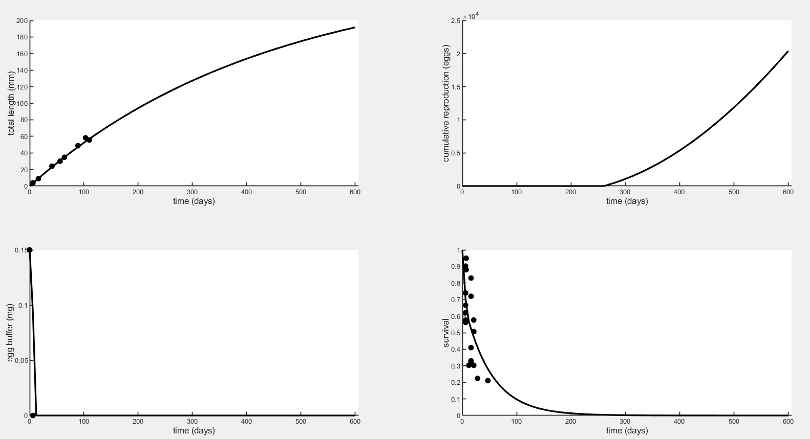
Plot to 600 days

Slide 4
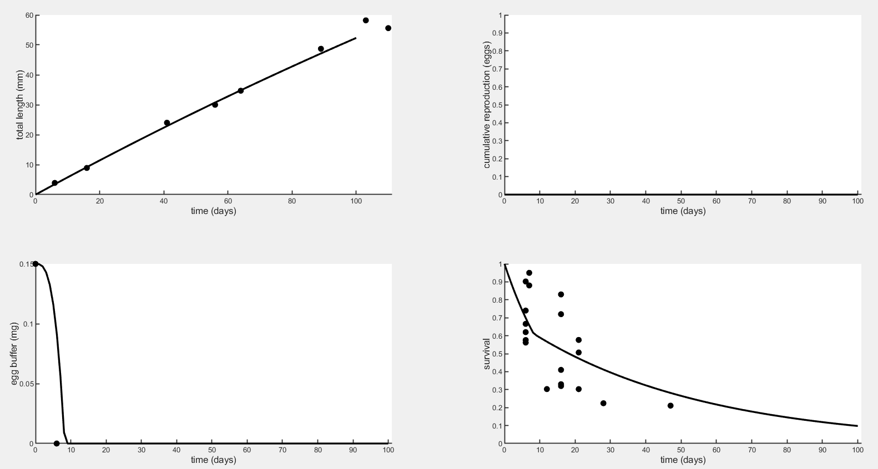
Plot to 100 days
R² = 0.99
R² = 0.24
R² = 0.41

Slide 5
Correlations of all pairs of 2 parameters
 | sJAm | sJM | WB0 | Lwp | yAV | yBA | yVA | kap | f | fB | Lwf | mu_emb | mu_lar
sJAm | 1
sJM | s | 1
WB0 | S | S | 1
Lwp | S | S | S | 1
yAV | S | S | S | S | 1
yBA | S | S | S | S | S | 1
yVA | s | 0.9937 | S | S | S | S | 1
kap | s | s | S | S | S | S | -0.9984 | 1
f | s | 0.9947 | S | S | S | S | s | s | 1
fB | s | s | s | s | s | s | s | s | s | 1
Lwf | 6.7e-8 | 0 | s | s | s | s | -6.2e-8 | S | 0 | s | 1
mu_emb | 0.02768 | -1.2e-3 | S | S | S | S | 0.02109 | 0.01904 | 4.4e-7 | s | S | 1
mu_lar | 0.04276 | -1.8e-3 | S | S | S | S | 0.03215 | 0.02893 | 6.4e-7 | s | s | -0.625 | 1
Bold ones are pairs that are not highly correlated.
Big S represents this warning message: “Matrix is singular to working precision”.
Little s represents this warning message: “Matrix is singular, close to singular, or badly scaled.”

Slide 6
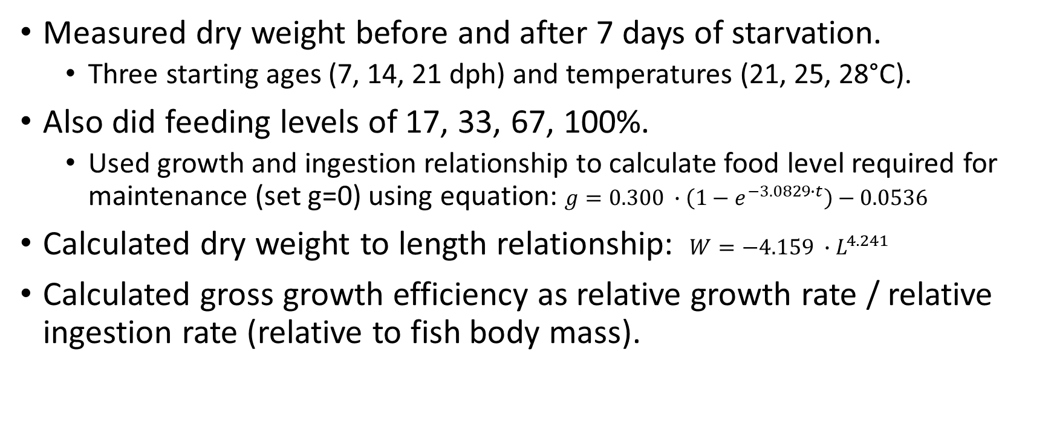
Letcher and Bengtson (1987) – Starvation, feeding rations, growth efficiency of M. beryllina ELS
Measured dry weight before and after 7 days of starvation.
Three starting ages (7, 14, 21 dph) and temperatures (21, 25, 28°C).
Also did feeding levels of 17, 33, 67, 100%.
Used growth and ingestion relationship to calculate food level required for maintenance (set g=0) using equation: $g=0.300 ∙\left(1−e^{−3.0829∙t}\right)−0.0536$
Calculated dry weight to length relationship: $W=−4.159 ∙L^{4.241}$
Calculated gross growth efficiency as relative growth rate / relative ingestion rate (relative to fish body mass).

Slide 7
Letcher and Bengtson (1987) – Starvation, feeding rations, growth efficiency of M. beryllina ELS
I extracted from plots the dry weights before and after starvation period to calculate change in weight per day at each temperature and age.

Slide 8
Letcher and Bengtson (1987) – Starvation, feeding rations, growth efficiency of M. beryllina ELS
Also plotted dry weight over time. Since there are only two time points it may be hard to estimate shape parameters of this relationship if assume nonlinear (i.e. in Stevenson et al. this was assumed to be exponential).
Note: y-axes are on different scales

Slide 9
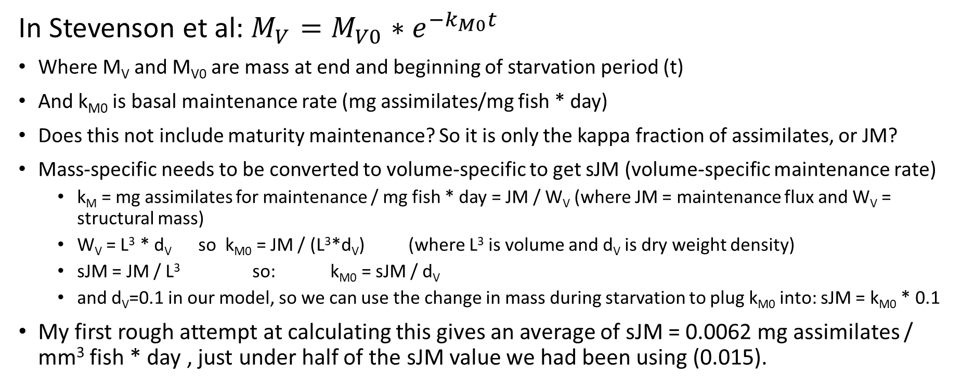
Getting Maintenance from Starvation
In Stevenson et al: $M_{V}=M_{V0}{∗e}^{{−k}_{M0}t}$
Where M_{V} and M_{V0} are mass at end and beginning of starvation period (t)
And k_{M0} is basal maintenance rate (mg assimilates/mg fish * day)
Does this not include maturity maintenance? So it is only the kappa fraction of assimilates, or JM?
Mass-specific needs to be converted to volume-specific to get sJM (volume-specific maintenance rate)
k_{M} = mg assimilates for maintenance / mg fish * day = JM / W_{V} (where JM = maintenance flux and W_{V} = structural mass)
W_{V} = L³ * d_{V} so k_{M0} = JM / (L³*d_{V}) (where L³ is volume and d_{V} is dry weight density)
sJM = JM / L³ so: k_{M0} = sJM / d_{V}
and d_{V}=0.1 in our model, so we can use the change in mass during starvation to plug k_{M0} into: sJM = k_{M0} * 0.1
My first rough attempt at calculating this gives an average of sJM = 0.0062 mg assimilates / mm³ fish * day , just under half of the sJM value we had been using (0.015).

Slide 10
Letcher and Bengtson (1987) – Starvation, feeding rations, growth efficiency of M. beryllina ELS
Which age(s) and temperature(s) to use to calculate sJM?
21 and 25°C are closest to most of the other data we have.
Should we assume linear, exponential, or something else for estimating maintenance rate from starvation weight change?
I am looking into this for more examples in literature
Linear and exponential gave similar k_{M0} values.

Slide 11
More details about how I got to the current version of the model
Data: Used early life length and survival, initial egg weight, and age at which egg buffer=0 (hatching).
‘Manually’ fitted initial parameters by running the code with fitting turned off, visually assessing fit, and adjusting initial parameters.
Estimate one parameter at a time and record AIC
There are some parameters we already know we want to fix because of available data.
Estimate two parameters at a time and record AIC and correlations of all pairs.
Focus mainly on parameters we may not want fixed: yVA or sJAm (not both), maybe mu_emb and mu_lar.
Jager suggests fixing yVA, yAV, and yBA at suggested values because of the data requirements.

Slide 12
Fitting for one parameter at a time, recording the estimate, AIC, and NLL below.
 | Initial parameters | Parameter estimates | AIC | Negative Log-Likelihood | Notes
delM | 0.1066 (data) | -
dV | 0.1 | -
sJAm | 0.2 | 0.2128 | 195.22 | 96.61 | TL and repro improved
sJM | 0.0062 (data) | 0.003061 | 196.25 | 97.12 | Growth very fast
WB0 | 0.15 (data) | 0.1500 | 204.00 | 101.00 | Nothing changed
Lwp | 115 (data) | 115.0 | 204.00 | 101.00 | Nothing changed
yAV | 0.8 | 0.8 | 204.00 | 101.00 | Nothing changed
yBA | 0.95 | 0.95 | 204.00 | 101.00 | Nothing changed
yVA | 0.11 | 0.1181 | 195.24 | 96.62 | TL improved, egg depleted faster
kappa | 0.8 | 0.8510 | 195.35 | 96.68 | TL improved, egg depleted slower
f | 1 (ad libitum) | 1.068 | 195.66 | 96.83 | TL improved, repro higher
fB | 1 |  |  |  | Egg depletion perfect
Lwf | 0 | 0 | 204.00 | 101.00 | Nothing changed
mu_emb | 0.07 | 0.05866 | 202.69 | 100.34 | Hatch surv higher
mu_lar | 0.02 | 0.02006 | 204.00 | 101.00 | Nothing changed
For reference: with no fitting or parameter estimation, only ‘manual’ fitting (selection of initial parameters): NLL=101.001 (AIC of 202).

Slide 13
Using the most influential parameters, fitting for combinations of two
Included: sJAm, sJM, yVA, kappa, and mu_emb
Best (or most influential) pairs and their respective AIC values:
sJAm & sJM – 62.04
sJAm & kappa – 63.98
sJAm & yVA – 75.00
All pairs except the following were highly correlated:
sJAm and Lwf, mu_emb, and mu_lar
sJM and Lwf, mu_emb, and mu_lar
yVA and Lwf, mu_emb, and mu_lar
Kappa and mu_emb and mu_lar
f and Lwf, mu_emb, and mu_lar
mu_emb and mu_lar
Included sJM and kappa in this exercise even though we plan to fix them.
sJAm and yVA are overall highly influential in fit, but are also highly correlated so one must be fixed.
There is a table of all combinations (not included here) if we want to look at this more. Correlations are on slide 5.

Slide 14
The slides after this one are unchanged from previous update.

Slide 15
Hypoxia effects on metabolism
P_{crit} by stage (ambient CO₂ group, no acidification):
Embryo: 2.044(±0.209) mg/L
2 days-post-hatch: 1.653(±0.154) mg/L
5 days-post-hatch: 1.561(±0.183) mg/L
Some embryos had no identifiable P_{crit}, fully oxygen-dependent (or oxyconforming)
Many individuals, especially larvae, showed a brief spike in oxygen consumption at very low O₂, likely due to stimulatory effects of anaerobic byproducts building up (lactate, etc.)

Slide 16
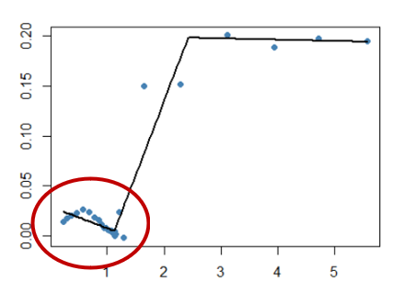
 |  | Ambient pCO₂ | Moderate pCO₂ | High pCO₂
Embryos | Exp. 1 (24°C) | 10% | 22.22% | 11.11%
 | Exp. 2 (22°C) | 18.18% | 16.67% | 35.71%
2dph Larvae | Exp. 1 (24°C) | 100% | 90% | 77.78%
 | Exp. 2 (22°C) | 66.67% | 83.33% | 53.85%
5dph Larvae | Exp. 1 (24°C) | 55.55% | 37.5% | 33.33%
 | Exp. 2 (22°C) | 85.71% | 40% | 75%
Oxygen consumption sometimes peaked in low oxygen, possibly due to stimulation from lactate buildup.
Embryos were often oxyconforming for entire trial (<5 mg/L).

Slide 17
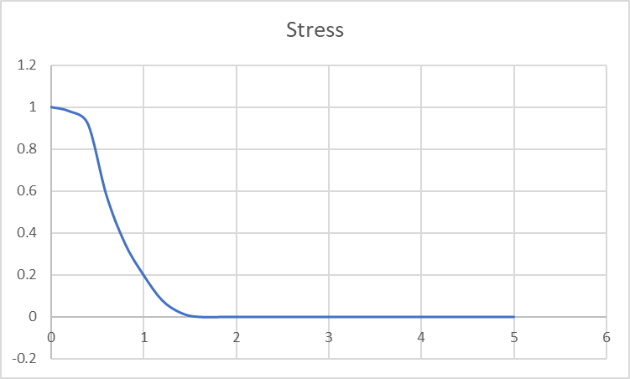
Asymmetric curve for additional stress at very low oxygen
Steeper increase in stress to near maximum when the low-oxygen MO2 spike occurs (red arrow).
This brings stress near the maximum until oxygen reaches zero.
Asymmetric logistic or sigmoid curve (e.g. shape of allosteric sigmoid function)
OR could have two stress functions, each to a different parameter and representing a different source of stress (being below Pcrit vs. having lactate accumulate).

Slide 18
Extra slides

Slide 19

$$M_{V}=M_{V0}e^{{−k}_{M0}t}$$
$$\frac{M_{V}}{M_{V0}}=e^{{−k}_{M0}t}$$
$$−ln⁡\left(\frac{M_{V}}{M_{V0}}\right)=k_{M0}t$$
$$\ln\left(M_{V0}\right)−ln⁡(M_{V})=k_{M0}t$$
$$\frac{\ln\left(M_{V0}\right)−ln⁡(M_{V})}{t}=k_{M0}$$

